Slide 1

What makes a good commit? Good Practices for Data Professionals
Rob Sewell

Slide 2

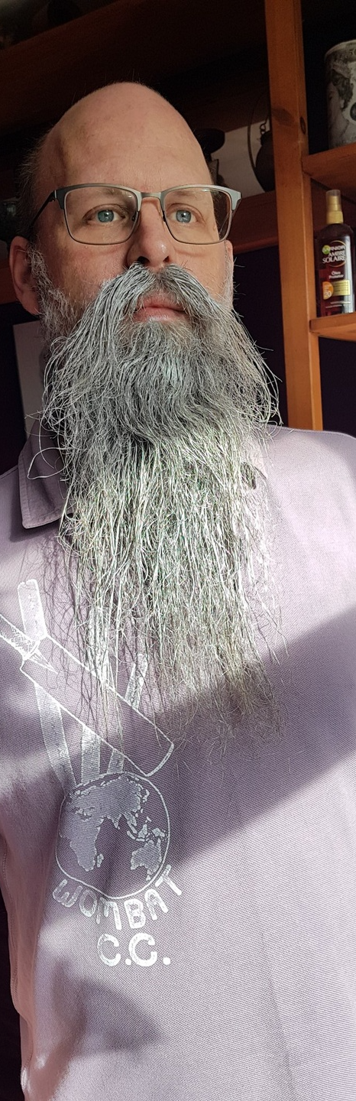




mrrobsewell@outlook.com
Rob Sewell
He/Him
I was a SQL Server DBA with a passion for Powershell, Azure, Automation, and SQL (PaaS geddit?) (And a sense of humour (and a habit for writing inside braces)). Now I just help other people with those (not the braces bit).
SEWELLS CONSULTING LTD
Beard Twizzler
MICROSOFT MVP
DATA PLATFORM 2020 - 2024
Cloud and data center management 2017 - 2024
INTERESTS
cycling, automation, Community
robsewell.com

Slide 3

Who writes code?
Notes:
Question​

Slide 4
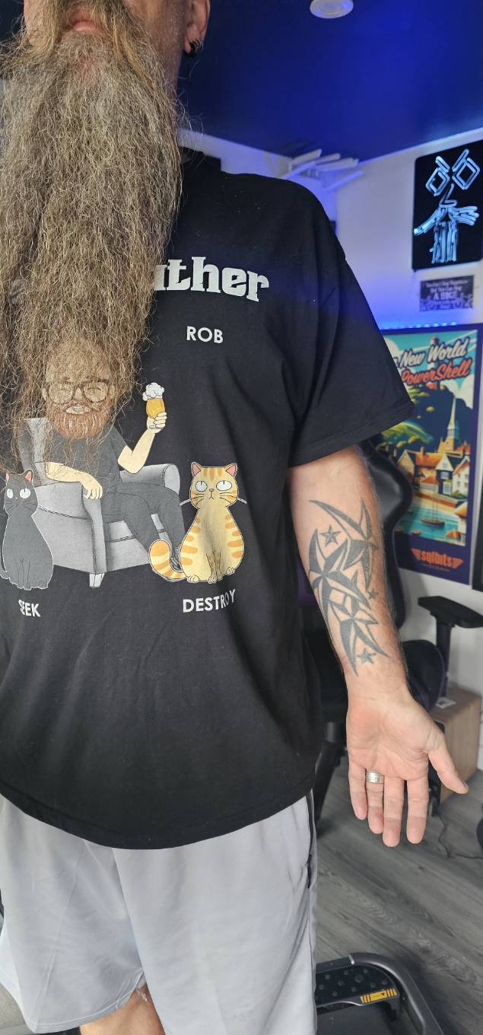
ALL teams that write code must use git - Bearded Fella – Some years ago
Notes:
If you write code, you should use source control to ensure that your source code is kept safe and improve HADR (Still a SQLDBA at heart see ☺ )​

Slide 5
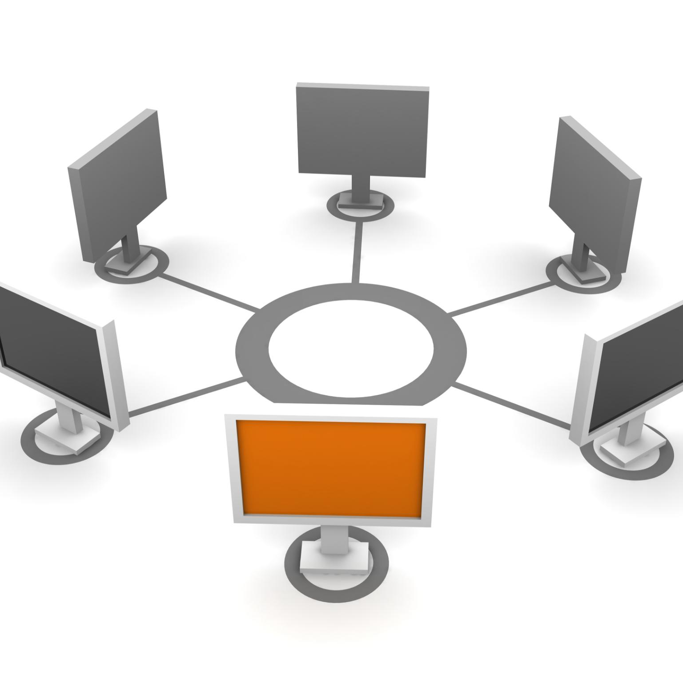

What is Git?
Version control system for tracking changes in files.
Notes:
Git is a distributed version control and source code management system that allows multiple people to work on the same codebase. It is widely used by software developers to manage code changes, track issues, and collaborate on projects. Git was created in 2005 by Linus Torvalds and is free and open source software.

Slide 6
What is Git?
Created in 2005
by Linus Torvalds.
Yes that one, the one that created Linux​
Notes:
Yes that one, the one that created Linux​

Slide 7
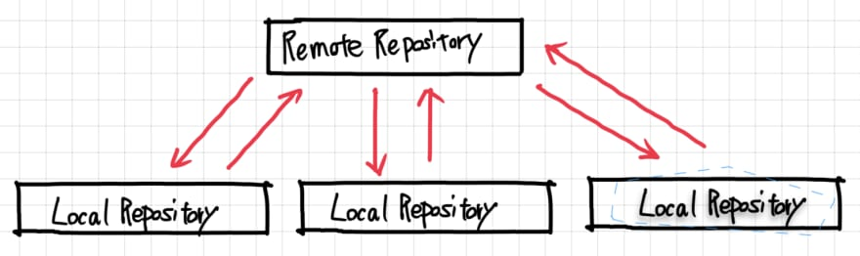
Notes:
GitHub, Azure Repos or a git server, they all work in the same sort of way​ A remote repo holds code that has been “committed and pushed” and each developer can work on their own version of the code on their own machine. Yes there are things like branches etc that you can explore ​

Slide 8
The power of version control systems like Git lies in merging many code changes from multiple developers smoothly while documenting the entire timeline and context.

Slide 9
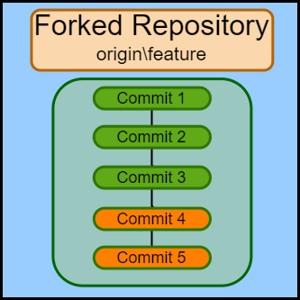
What is a Commit?
Notes:
It is the reference for a change

Slide 10
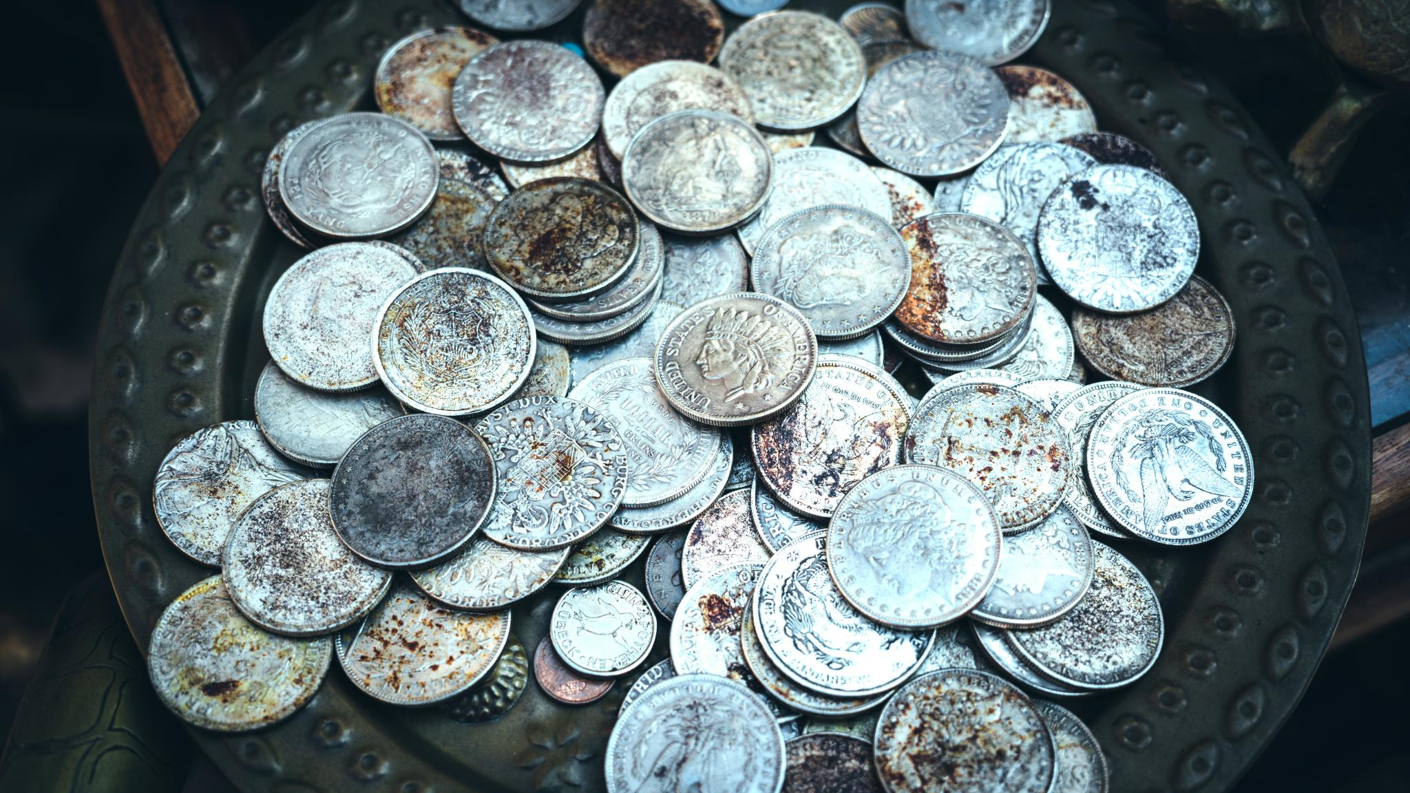
NOT that sort of change !!
Thanks AI !!
Notes:
Not that sort of change

Slide 11
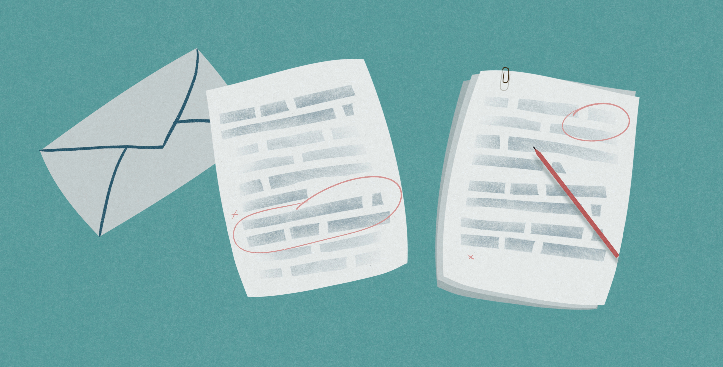
Notes:
Normally the change between the contents of files – the CODE
But can be greater than one file

Slide 12
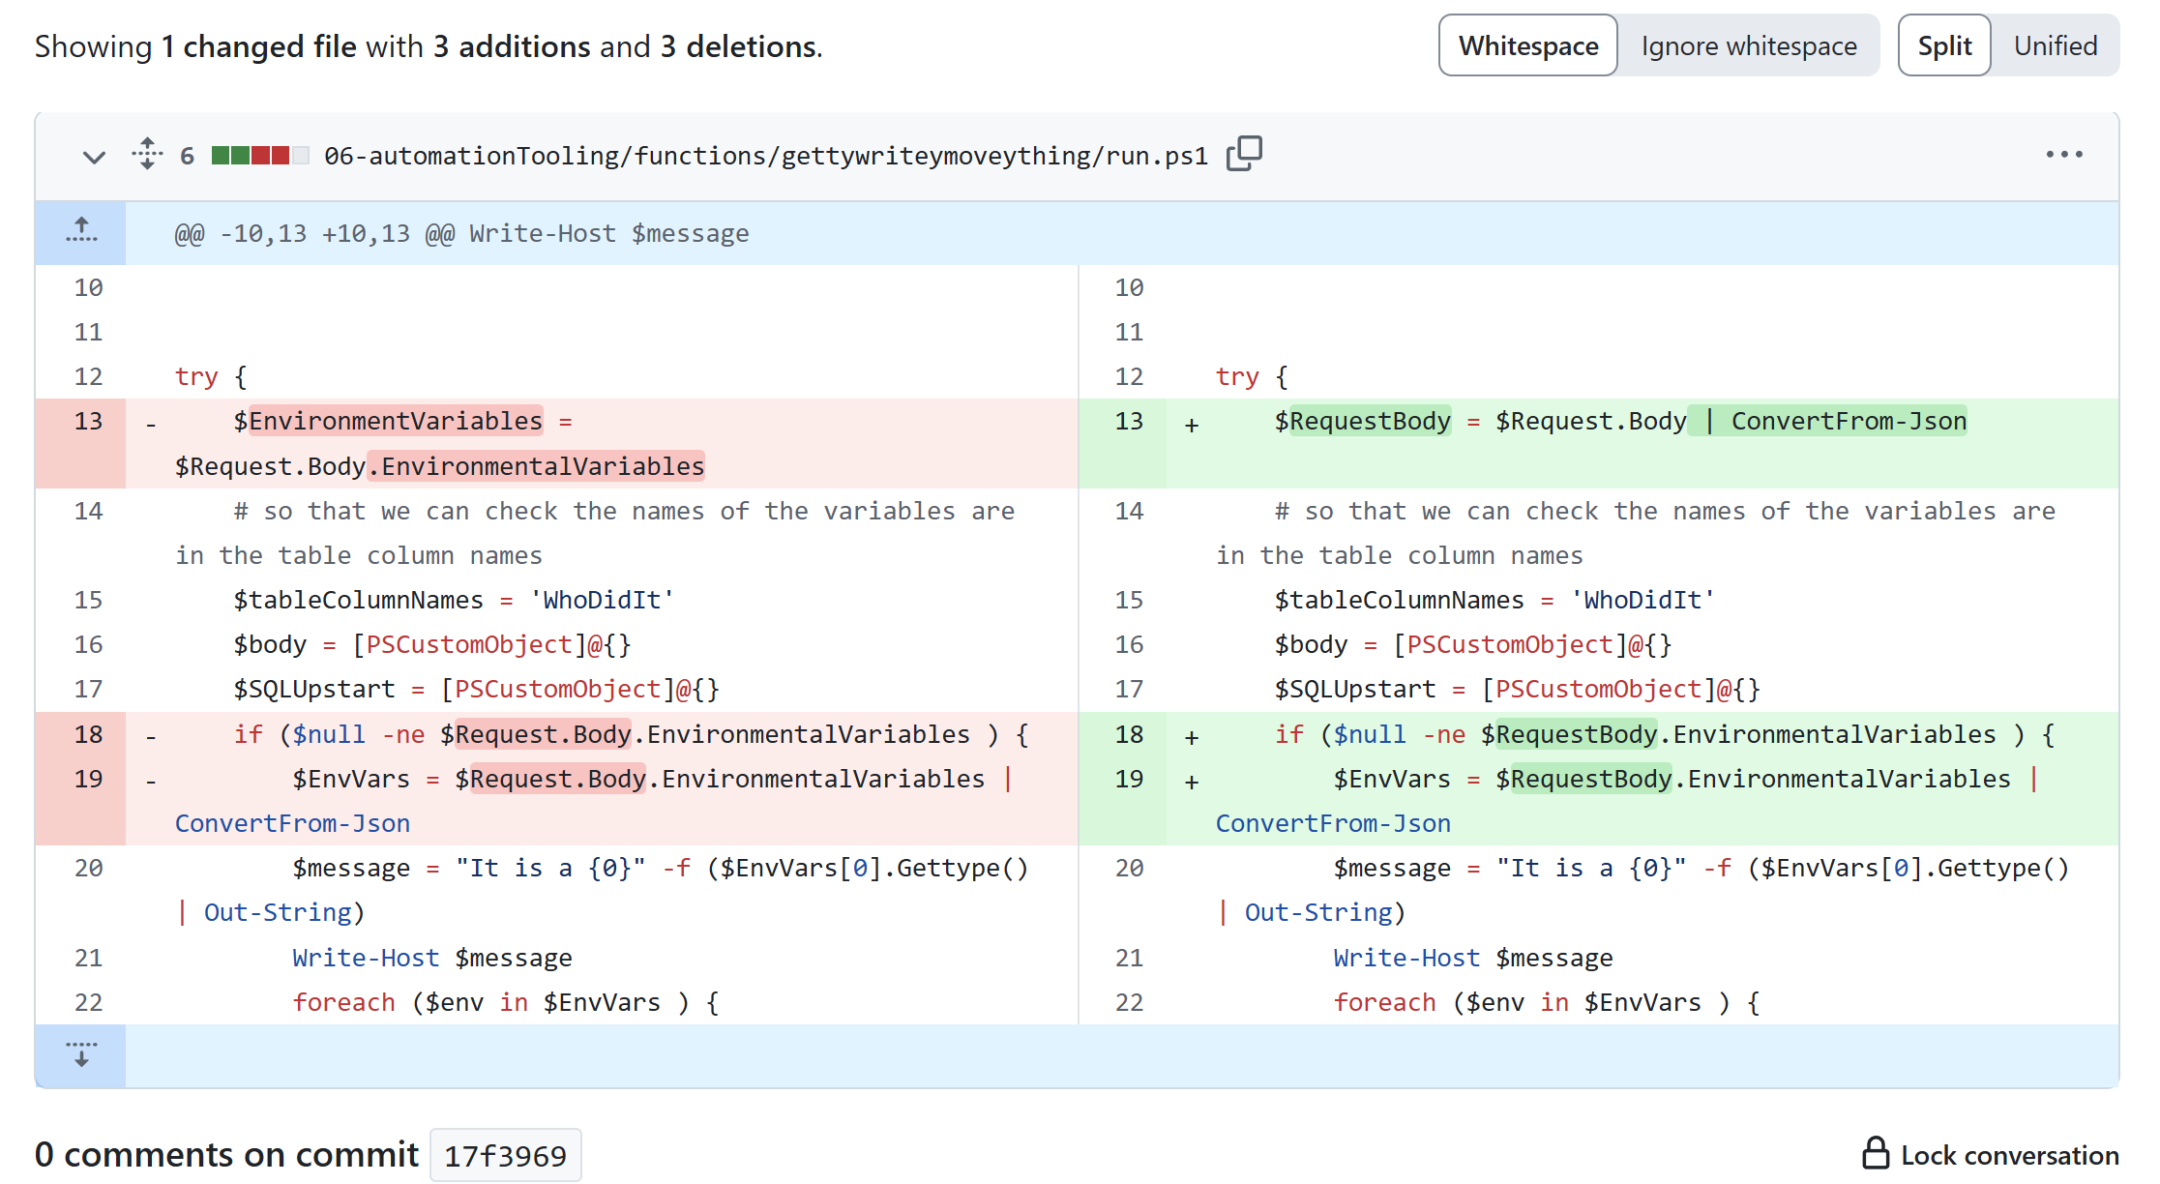
Notes:
Here is a graphic showing the changes in a commit for a single file. Red is taken away and green is added. GitHub, Azure Repos in the browser or VSCode and other code editors on your machine can show you the changes graphically or you can use the CLI​

Slide 13

Its linear
Notes:
It always moves forward, like a SQL db transaction log ,of course you can “revert” but that happens going forward also

Slide 14
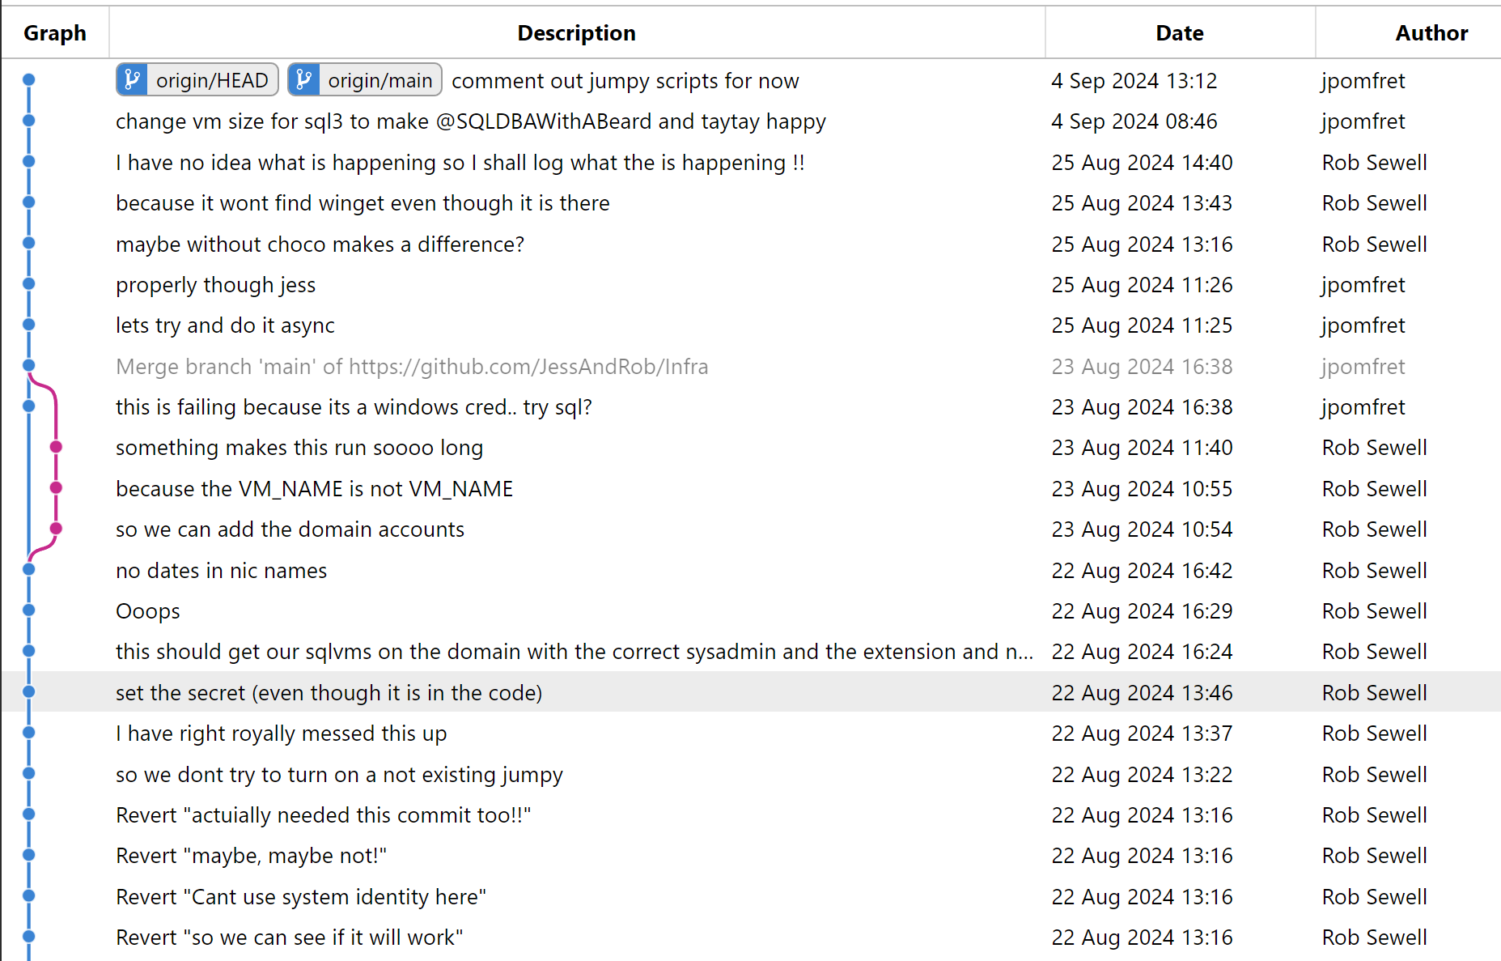

Slide 15
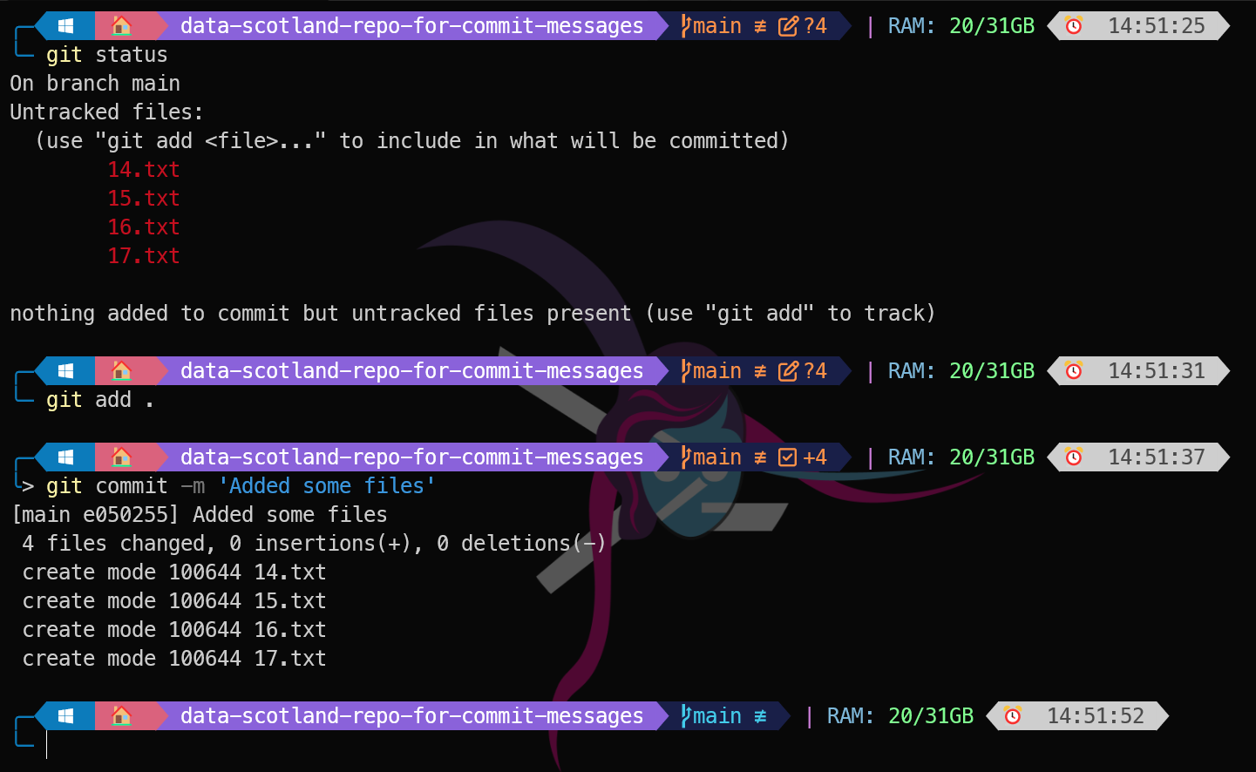
Notes:
Here is a commit message

Slide 16

What is a commit message ?

Slide 17
Notes:
Status to see what we have – this has 4 files to add
We add them
We write git commit –m (or just git commit to open the editor

Slide 18
Notes:
Write a commit message

Slide 19
Notes:
Git SHA (Secure Hash Algorithm) is calculated and the concept of feature branches.
Understanding Git SHA
In Git, every commit, file, and object is identified and tracked using a unique 40-character hexadecimal string known as a Git SHA. This SHA is calculated based on the contents of the object using a cryptographic hash function. The SHA ensures data integrity and guarantees that the object remains unchanged. Any modification to the content results in a different SHA, alerting Git to the change.

Slide 20
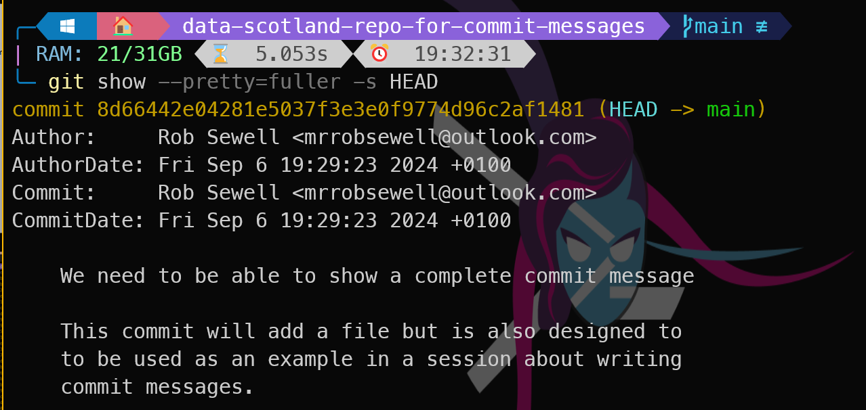
Notes:
Here you can see a full commit The author is the person who originally wrote the code. The committer, on the other hand, is assumed to be the person who committed the code on behalf of the original author. This is important in Git because Git allows you to rewrite history, or apply patches on behalf of another person.

Slide 21

What shouldn’t a commit message contain?

Slide 22
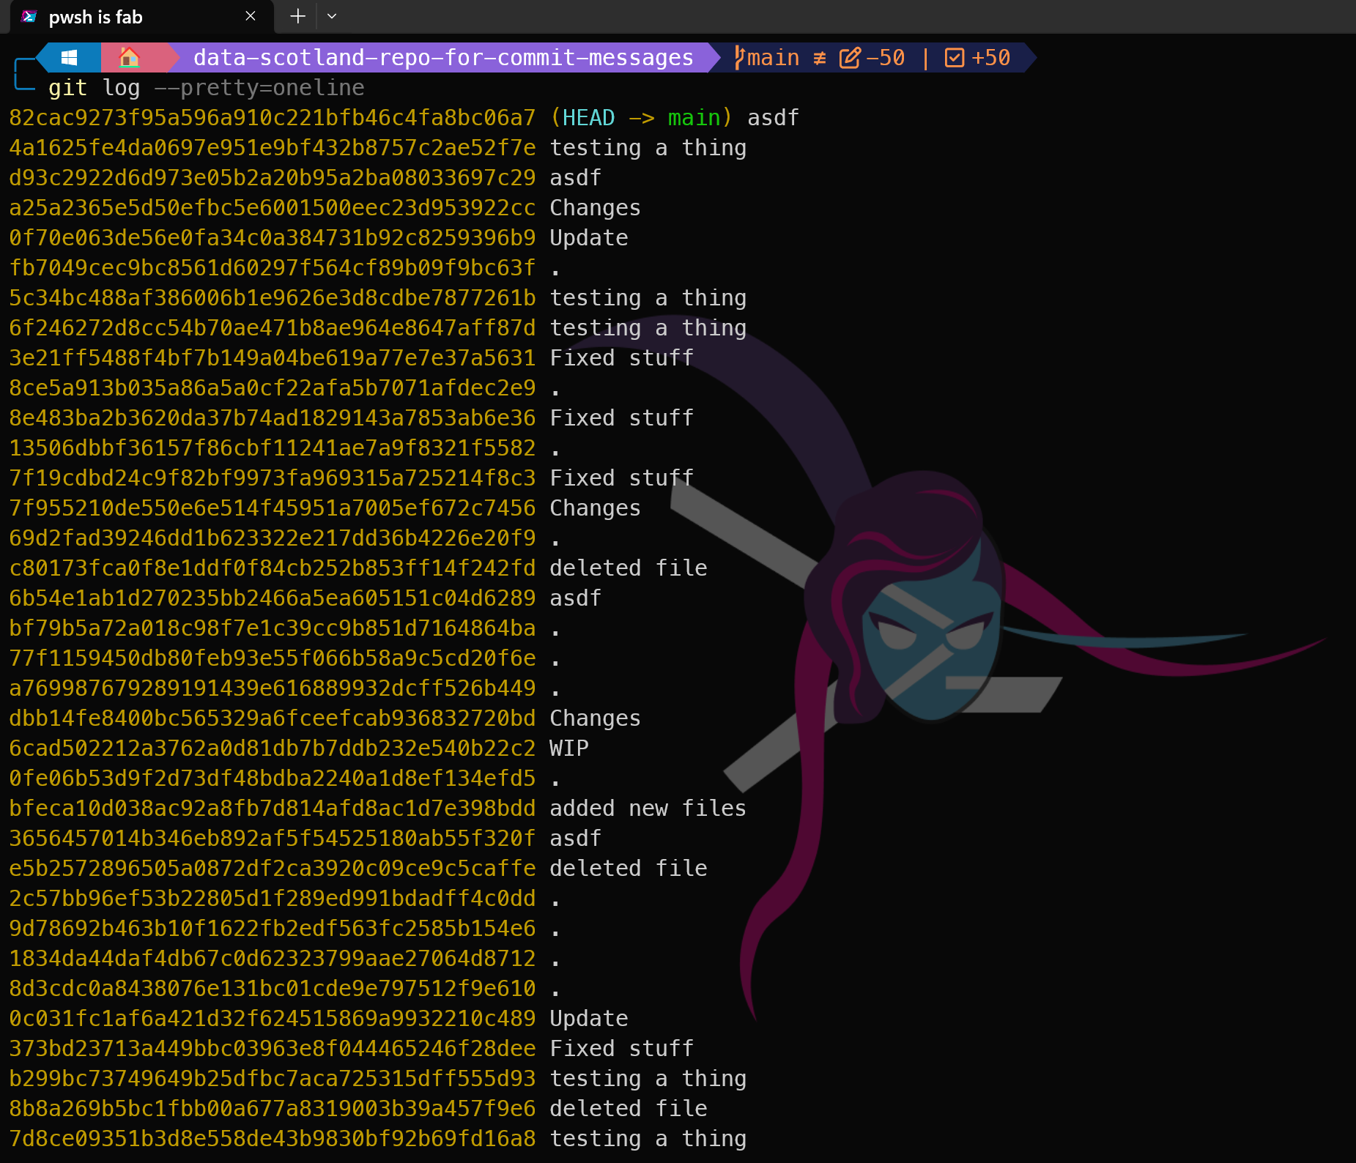
Notes:
I see all of these, they are pointless, they achieve nothing. Using commit messages like this means that you are not using git but just trying to get things forward quickly – like the reject all cookies pop-up​

Slide 23
Should not describe “What changed”
because as we saw any tool can identify the differences

Slide 24
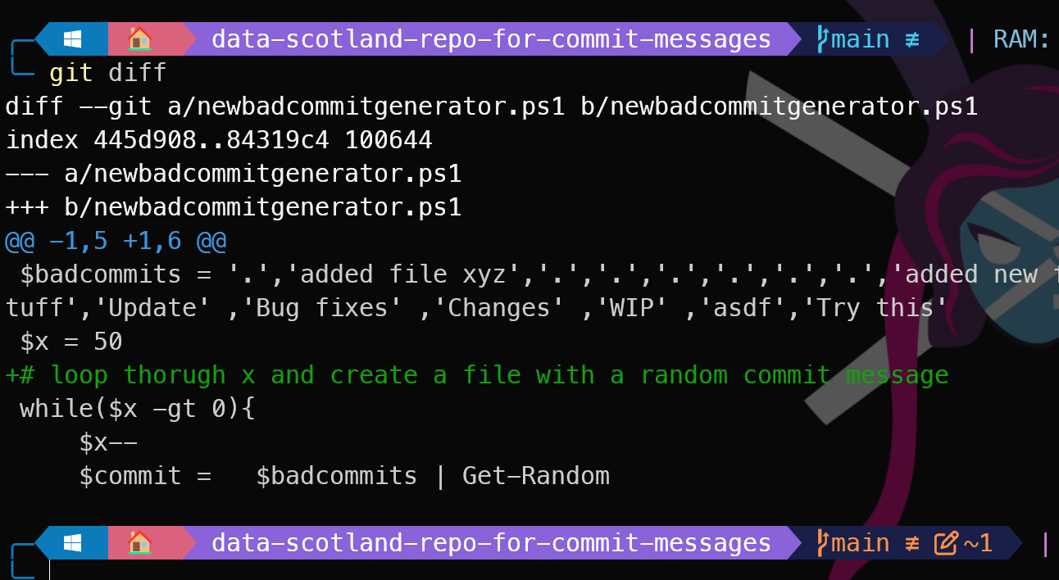
Notes:
Even at the command line

Slide 25
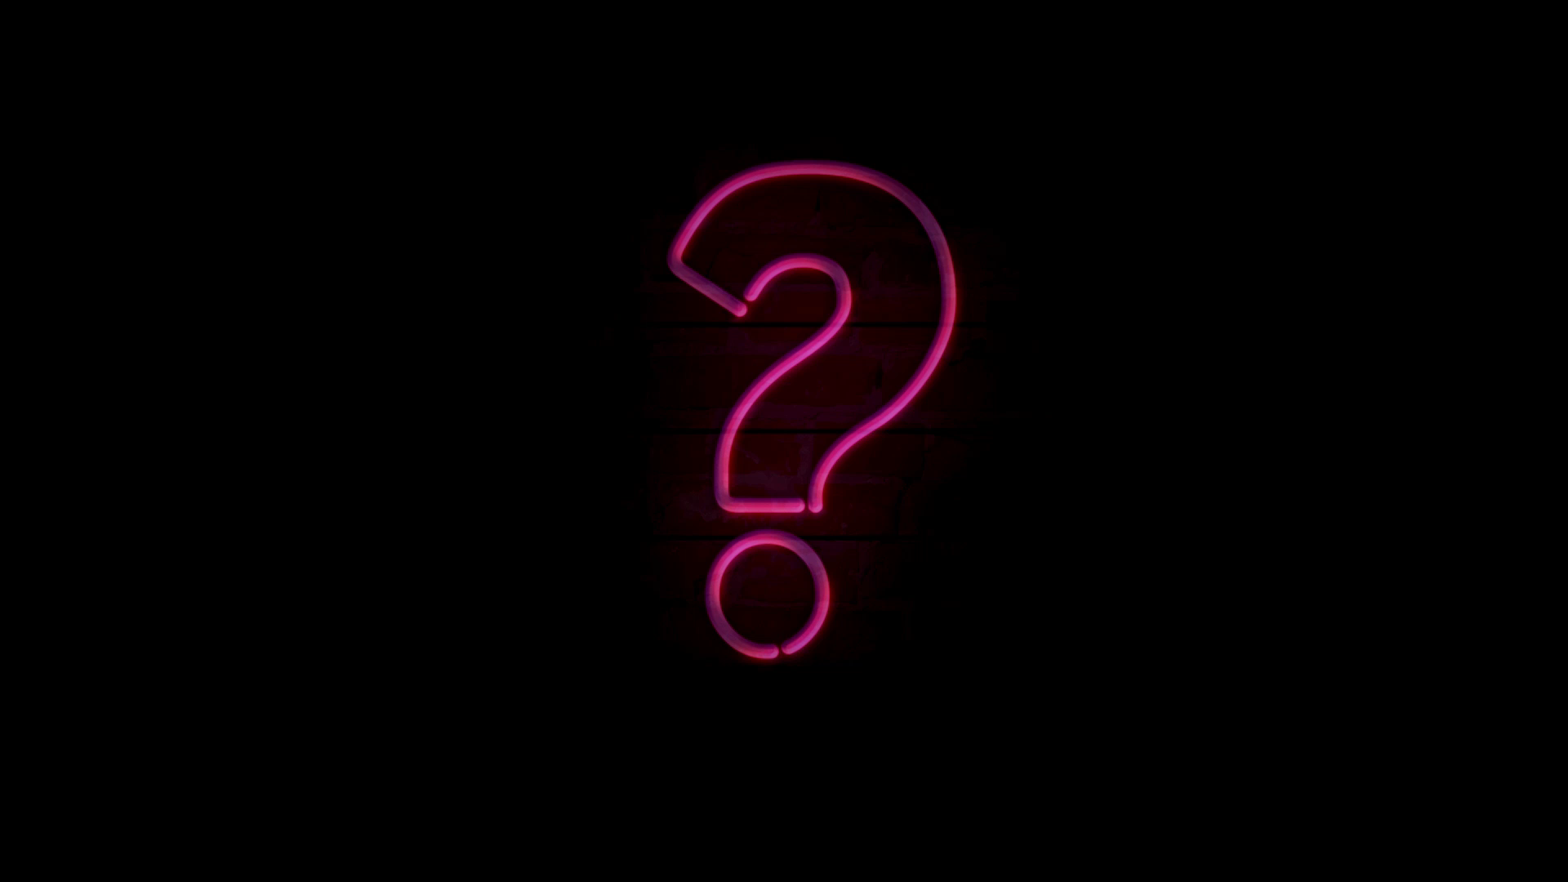
Why?

Slide 26
A commit message should
Show the WHAT
Notes:
Commit message should
Show the What ( WAIT A MINUTE – YOU LITERALLY SAID DON’T SHOW THE WHAT)
Show the What …. You expected the change to achieve
Show the Why Explain the change for collaboration (Pull Request) Explain the change for future
You
Your team
The person that replaced you and knows where you live !!

Slide 27
You JUST said
WAIT A MINUTE
Notes:
Commit message should
Show the What ( WAIT A MINUTE – YOU LITERALLY SAID DON’T SHOW THE WHAT)
Show the What …. You expected the change to achieve
Show the Why Explain the change for collaboration (Pull Request) Explain the change for future
You
Your team
The person that replaced you and knows where you live !!

Slide 28
A commit message should Show
What you Intended the change to achieve
Notes:
Commit message should
Show the What ( WAIT A MINUTE – YOU LITERALLY SAID DON’T SHOW THE WHAT)
Show the What …. You expected the change to achieve
Show the Why Explain the change for collaboration (Pull Request) Explain the change for future
You
Your team
The person that replaced you and knows where you live !!

Slide 29
A commit message should Show
Why the change was made
Notes:
Commit message should
Show the What ( WAIT A MINUTE – YOU LITERALLY SAID DON’T SHOW THE WHAT)
Show the What …. You expected the change to achieve
Show the Why Explain the change for collaboration (Pull Request) Explain the change for future
You
Your team
The person that replaced you and knows where you live !!

Slide 30
A commit message should
Explain the change for others
Notes:
Commit message should
Show the What ( WAIT A MINUTE – YOU LITERALLY SAID DON’T SHOW THE WHAT)
Show the What …. You expected the change to achieve
Show the Why Explain the change for collaboration (Pull Request) Explain the change for future
You
Your team
The person that replaced you and knows where you live !!

Slide 31

What is a commit message for?
What can/should it be used to achieve ?

Slide 32

Peer Review and Pull Request
Peer review is an essential process in ensuring code quality. Commit Messages can explain what was intended easing the PR process
Notes:
Peer review is an important part of ensuring code quality and should be an integral part of the development process. Code reviews should focus on code readability, maintainability, and adherence to best practices.

Slide 33

Collaboration
Notes:
Creating high-quality commits is an essential part of the software development process. By following the best practices for creating high-quality commits, data professionals can ensure that their codebase remains stable, maintainable, and scalable.

Slide 34

What else is a commit message useful for?

Slide 35

Searching

Slide 36
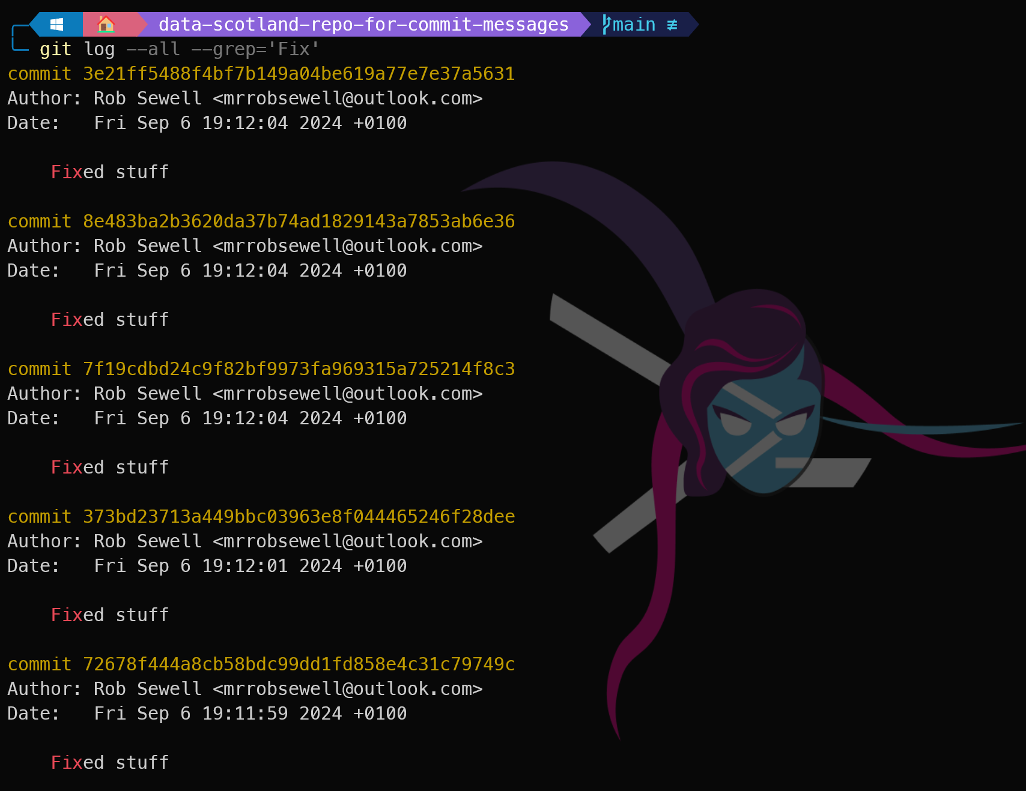

Slide 37
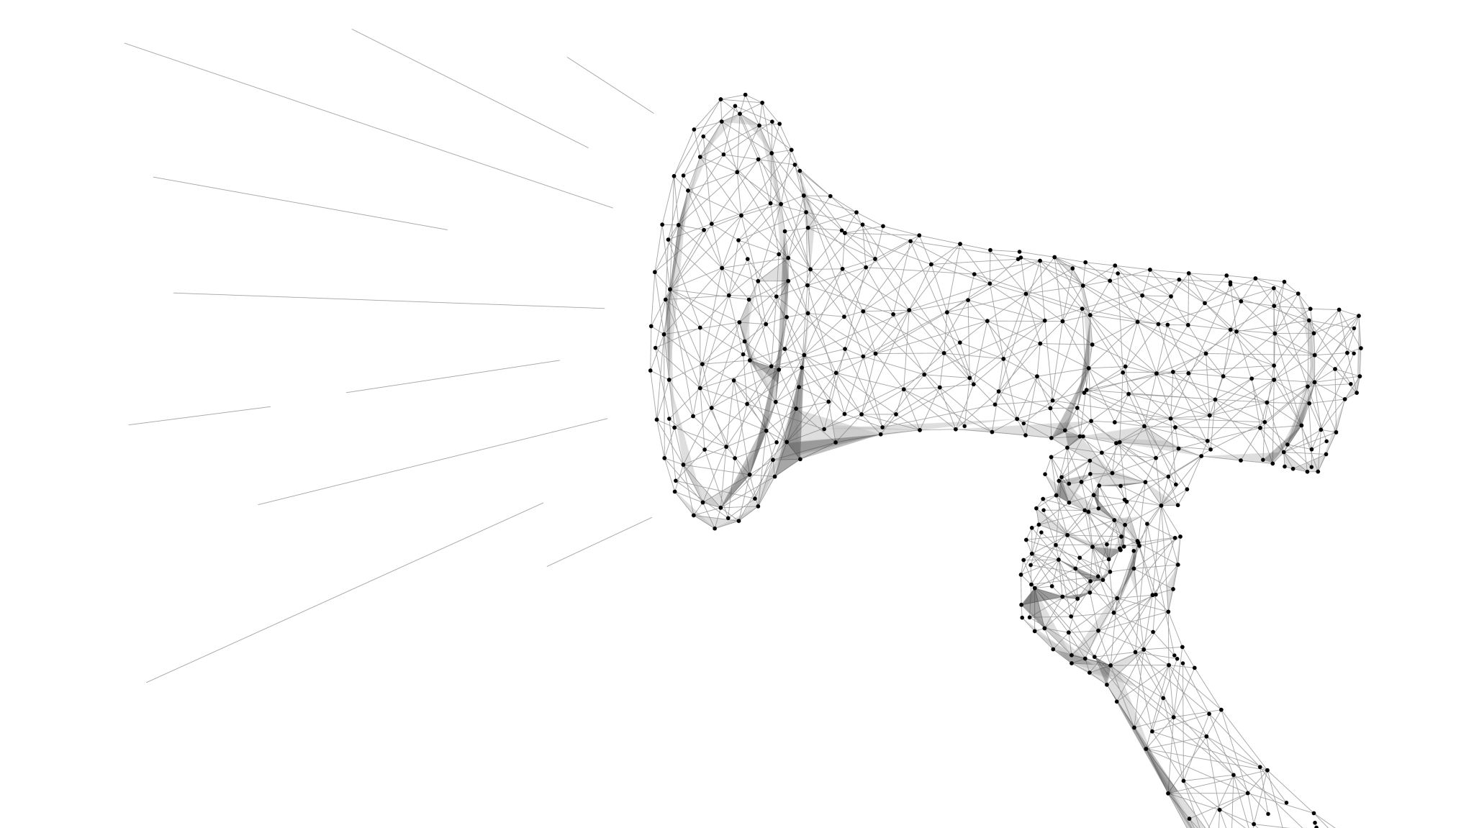
Blaming

Slide 38
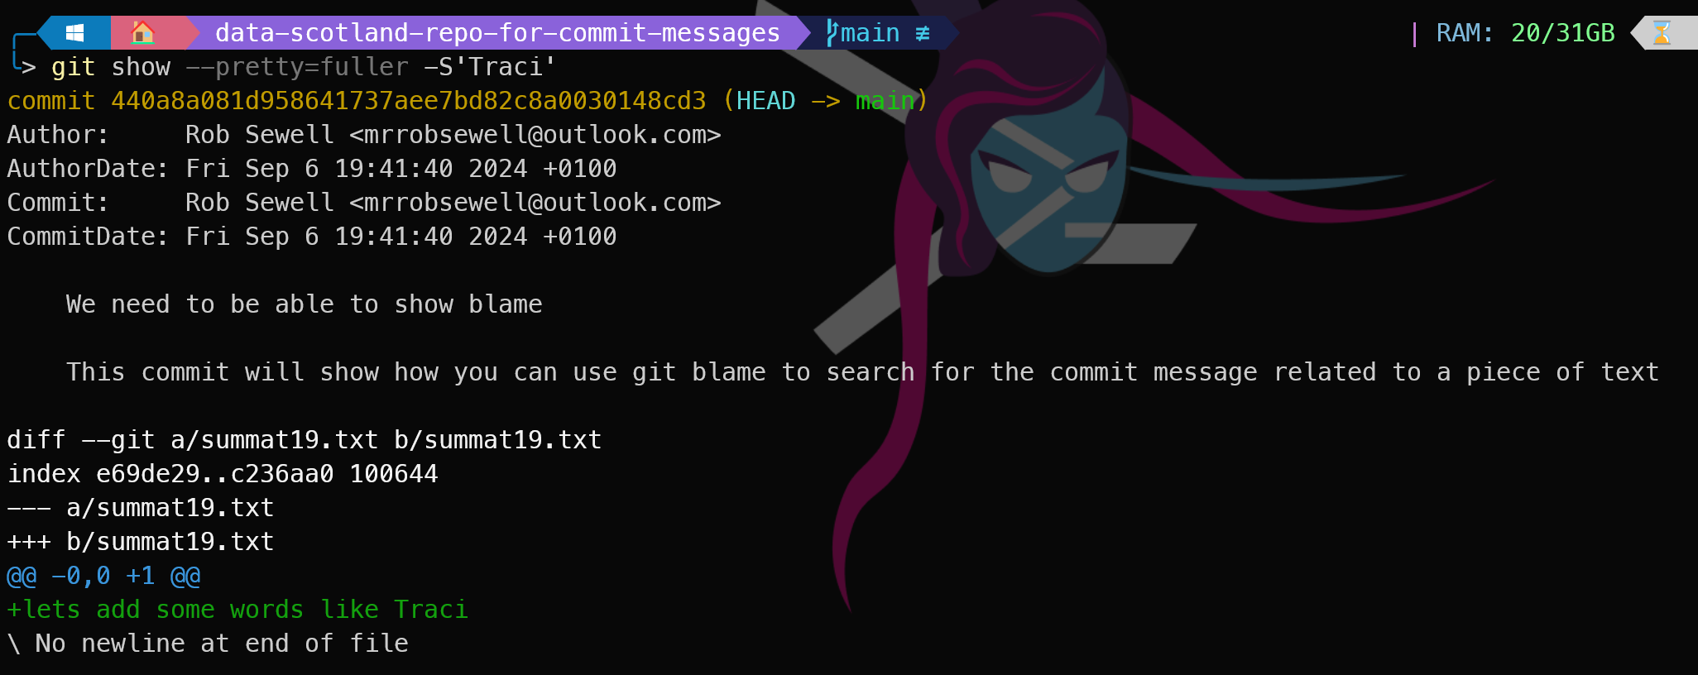

Slide 39
Telling a story

Slide 40
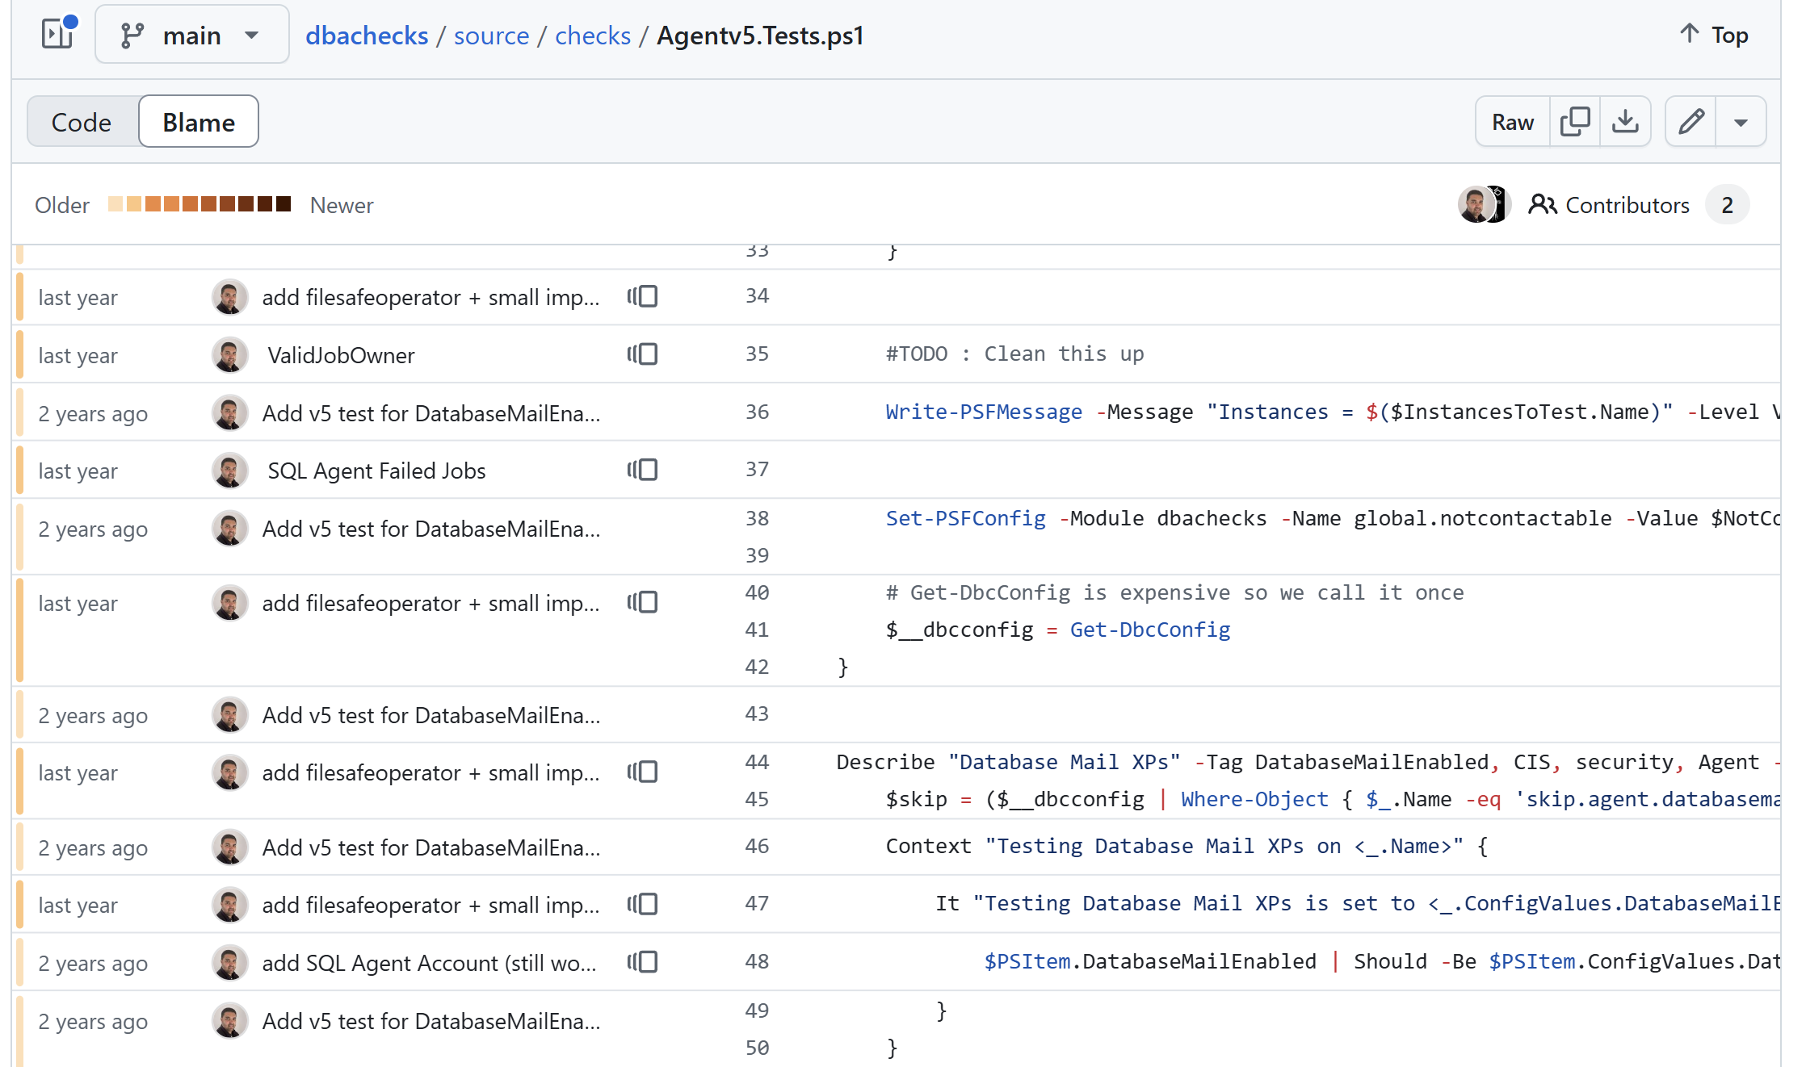

Slide 41
That was all very serious and for work it is important

Slide 42

You can have fun as well ☺

Slide 43
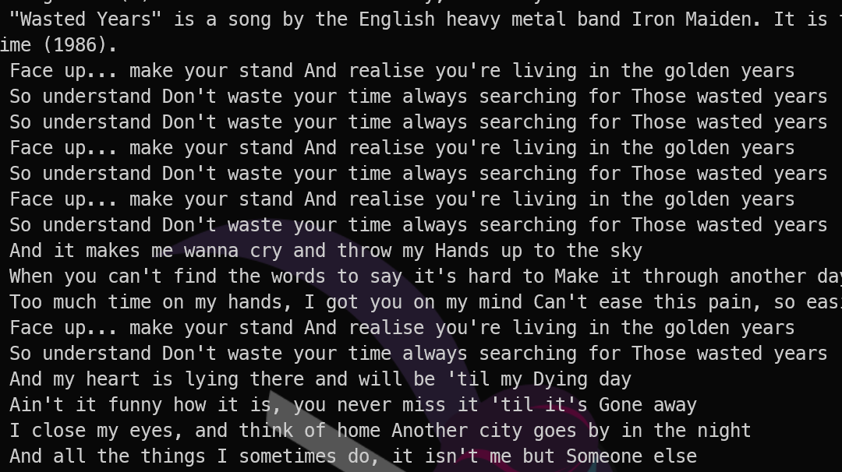
I am soley talking about Work commits here – Your own open source project, rules can be looser
Notes:
You can use song lyrics ☺

Slide 44
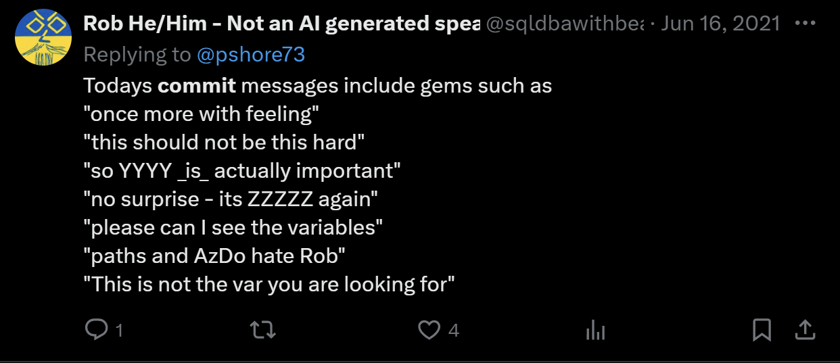
I am soley talking about Work commits here – Your own open source project, rules can be looser

Slide 45
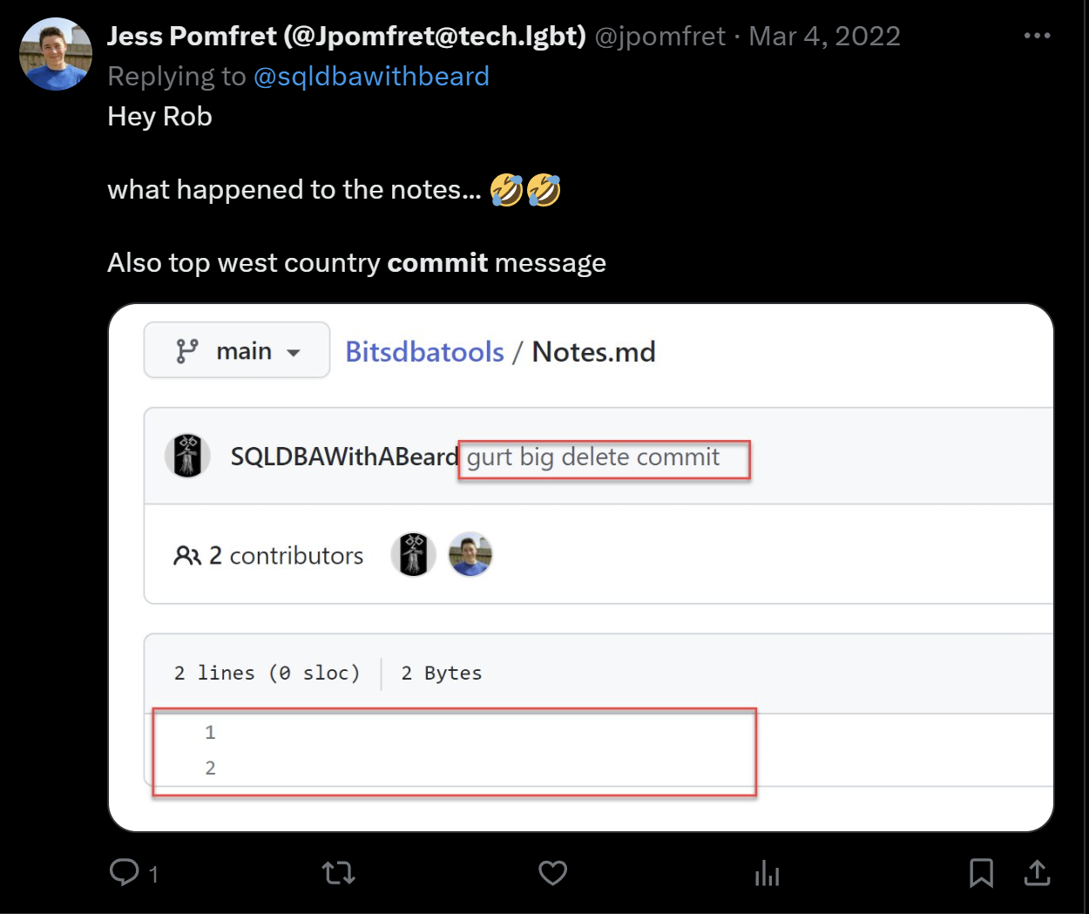
I am soley talking about Work commits here – Your own open source project, rules can be looser

Slide 46
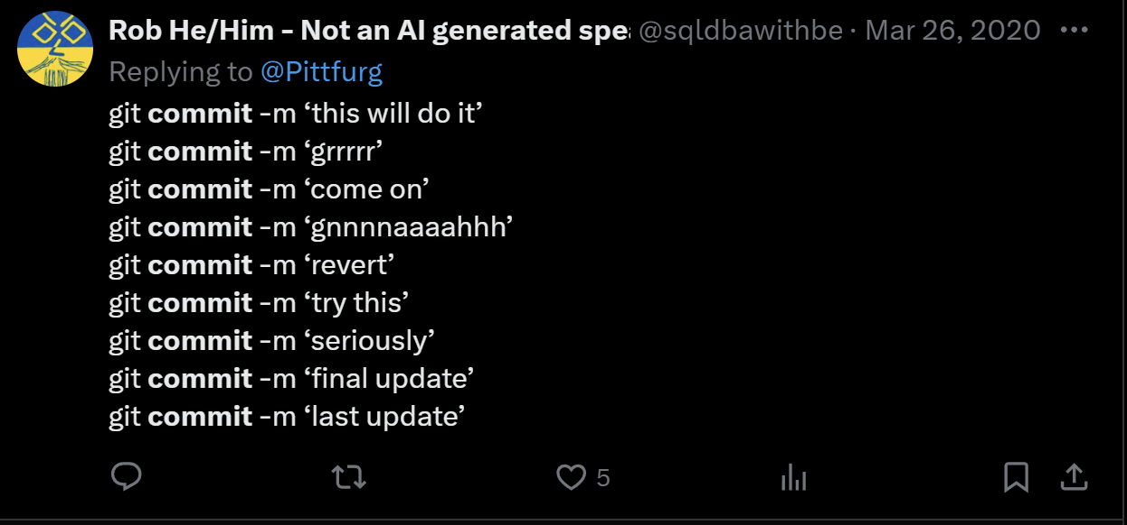
I am soley talking about Work commits here – Your own open source project, rules can be looser

Slide 47
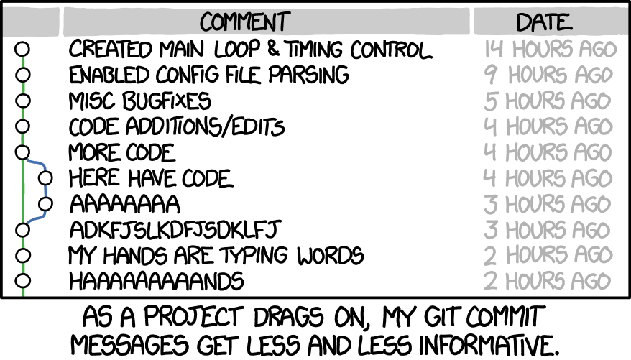

Slide 48
Working in a team
Just like coding guidelines, you should discuss and agree and document AND follow some rules

Slide 49
What Does a commit message look like?
What language should it be written in?

Slide 50
What Does a commit message look like?
What language should it be written in?
What does it look like? Capitilisation ?

Slide 51
What Does a commit message look like?
What language should it be written in?
What does it look like? Capitilisation ?
Title and body
Reference to work items etc

Slide 52
What Does a commit message look like?
[Action Word] [item] [reference]
Added | Feature | #123456
Removed | Class | Confluence 43231
Updated | Procedure | Work Item 1234
Altered | View | Task 34
Simplified | Template | Tag 76
Linked | Function | The boss said so

Slide 53

Clear and Concise Message
A clear and concise commit message is important because it helps other developers understand the changes made in the commit and provides context for future development.
Notes:
A good commit message should be clear, concise, and informative. It should summarize the changes made in the commit and provide enough context for other developers to understand the changes.

Slide 54
Some Other Suggestions
You can follow these rules for creating the great commit message
Limit the subject line to 50 characters
Capitalize the subject/description line
Do not end the subject line with a period
Separate the subject from the body with a blank line
Use the imperative mood in the subject line
Wrap the body at 72 characters
Use the body to explain what and why
Notes:
While the imperative mood gives commands or requests, the indicative mood is used to make statements or ask questions.
Doing rather than statement

Slide 55

Here is a good place to start
https://udacity.github.io/git-styleguide/

Slide 56
LASTLY
Don’t use just a
.
for your commit message
Notes:
imagine

Slide 57
Linking to work items and tasks – auto closing Fixes etc
Auto generation of Release notes
This will be in the 50 minute session and not the 20 minute

